Slide 1
Student Result Management System
Course Instructor: Presented by:
N.AKHILA, M.Tech (Ph.D),
ASSISTANT PROFESSOR,
AIML DEPTARTMENT
25B11AIA99 | SHAIK.BALASAIDA
25B11AI666 | MAKARLA SRI SUSWAR
26B21AI087 | N.JAYA NAGA SATISH
26B21AI040 | G.AJAY KUMAR

Slide 2
Contents
Abstract
Introduction
Problem Statement
Objectives
Key Features
Modules and Functions
Implementation
C++ Concepts Used
Inputs
Expected Outputs
System Flowchart
Team Contribution
Conclusion
References

Slide 3
Project Abstract
The Student Result Management System is a menu-driven C++ application for managing semester results.
Stores student details, including roll number and name
Records marks for five subjects per student
Calculates subject grades, SGPA, CGPA, and percentage
Displays individual results and class summaries
Lists semester toppers and pass/fail results

Slide 4
Introduction :
Student results involve marks and credits across multiple subjects.
Manual calculations can take time and may lead to errors.
This project organizes student and subject information in a C++ application.
Users can enter marks, search for students, and view result summaries.
The project demonstrates object-oriented programming and basic data processing.

Slide 5
Problem Statement & Objectives
Problem Statement:
Managing semester results manually makes it harder to track subject marks, calculate grades, and prepare student or class summaries.
Objectives:
Store student and semester information
Record marks for five subjects
Calculate grades and grade points
Calculate SGPA, CGPA, and percentage
Find a student by roll number
Display topper, pass/fail, and class summary information

Slide 6
Novelty Of The Project
Menu-driven interface for result management
Student registration with roll number and name
Semester selection from 1 to 8
Marks and credits recorded for five subjects
Automatic subject grading and result calculations
Pass condition checks subject total and external marks
Individual result display and class reporting

Slide 7
Modules / Functionalities
Student Module:
Student::addStudent() — records student details and semester
Student::getRollNo() — returns the student roll number
Student::getName() — returns the student name
findStudent() — searches the student list by roll number
Marks Module:
Student::enterMarks() — records subject details and marks
Student::calculateResult() — calculates grades, SGPA, CGPA, and percentage

Slide 8
Modules / Functionalities
Result Display:
Student::displayResult() — shows marks, grades, and semester result
Student::displaySGPACGPA() — shows SGPA and CGPA
Reports:
showTopper() — displays the student with the highest SGPA among students with results
showPassFailList() — lists students who passed or failed
showClassSummary() — shows result counts and average SGPA

Slide 9
Implementation
Developed in C++
Student class stores each student’s information and result
Subject structure stores subject marks, credits, grade, and pass status
A vector<Student> stores student records during program execution
Each student record supports five subjects
Students in semesters after the first can enter previous credits and CGPA
Records are stored in memory and are cleared when the program exits

Slide 10
C++ Concepts Used
Classes and objects: represent students and their results
Structures: group subject details
Encapsulation: keeps student data within the Student class
Member functions: separate data entry, calculations, and display
Vectors: store a changeable number of student records
Arrays: store the five subjects for each student
Loops and conditions: process entries and calculate results
Strings: store names, roll numbers, and subject information

Slide 11
Inputs
Student roll number
Student name
Semester number
Previous total credits and CGPA for semesters 2–8
Subject code, name, and credits
IE1, IE2, internal, and semester-end marks
Menu choice and roll number for lookup

Slide 12
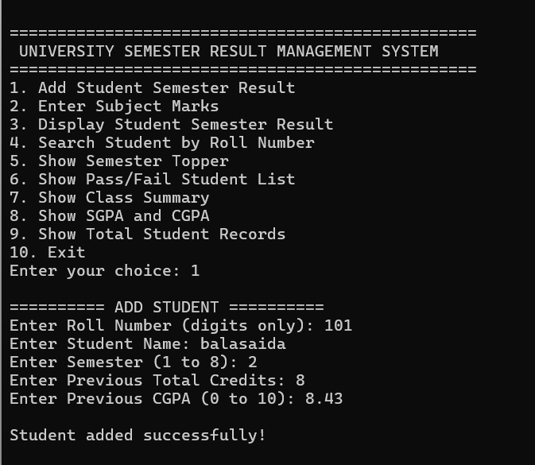
Inputs

Slide 13
Expected Outputs
Student registration confirmation
Subject marks and grades
Subject pass/fail status
Percentage, SGPA, and CGPA
Complete result for a selected student
Semester topper
Pass/fail student lists
Class result counts and average SGPA
Total number of student records
Messages for missing students or unavailable marks

Slide 14
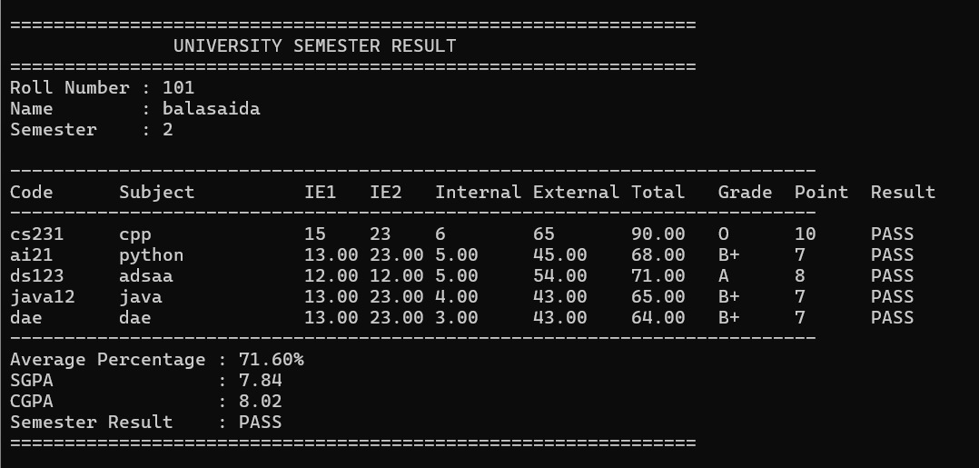
Outputs

Slide 15
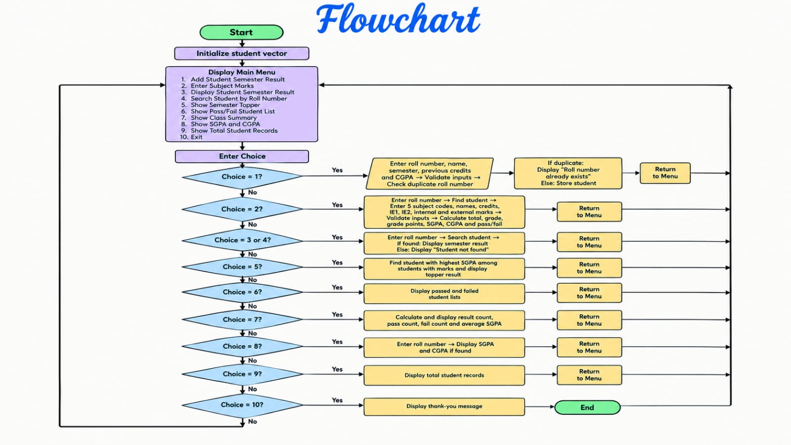

Slide 16
Role of Each Individual
Roll No. | Name | Role / Responsibility
25B11AIA99 | SK.BALASAIDA | Class design, Event & Registration modules
25B11AI666 | M SRI SUSWAR | Coding – core modules & file handling
26B21AI087 | N.JAYA NAGA SATISH | Testing, debugging & report generation
26B21AI040 | G.AJAY KUMAR | UI design, documentation & presentation

Slide 17


